Slide 1
Use of modern technologies in psychological research: Case study
Possible applications during MACICT Project Marta Kowal, Małgorzata Sobol-Kwapińska Institute of Psychology, University of Wroclaw
The 2nd MACICT Meeting
Wrocław, 23-25 October 2019
Institute of Psychology
2020 Conference
Funding:
National Polish Center 2016/23/B/HS6/03888

Slide 2
Can engineers help psychologists in conducting studies?

Slide 3
The answer is…
Source: Public copyright license

Slide 4
HOW?
With the use of modern technologies*
* But, of course, not only with the use modern technologies :-)

Slide 5
What kind of modern technologies are we talking about?

Slide 6
Modern technologies used for:
Acquiring data
Creating databases
Data analysis
Presenting data

Slide 7
1. Acquiring data
Creating needed devices and sensors:
1) breathing sensor (Czub & Kowal, 2019)
Source: own.

Slide 8
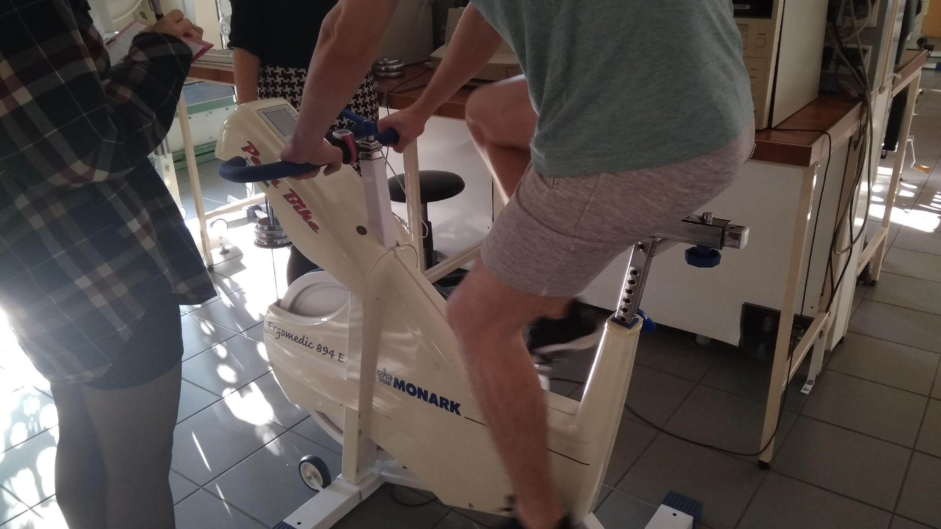
1. Acquiring data
Creating needed computer software:
2) Software for stationary bike (Kowal, Piskorz, & Czub, in preparation)
Source: own.

Slide 9
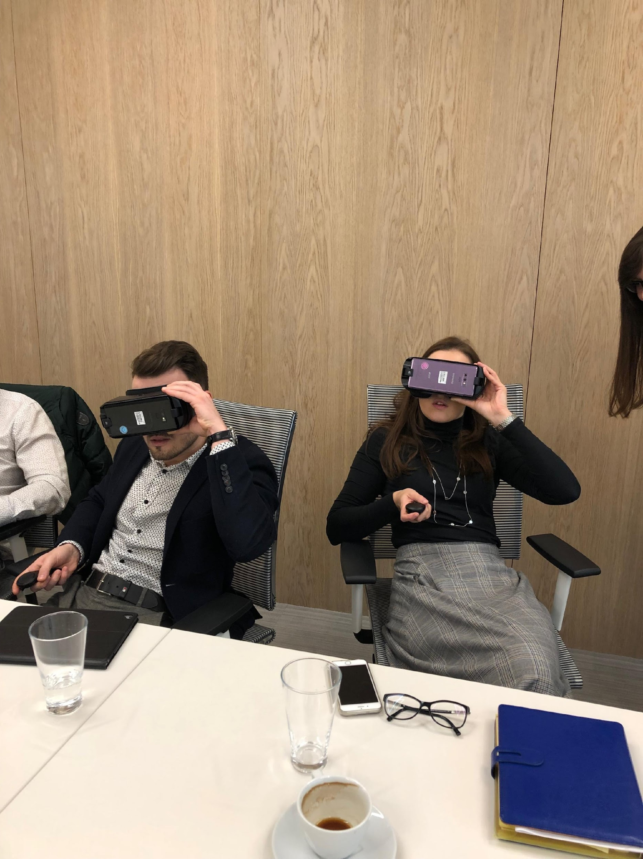
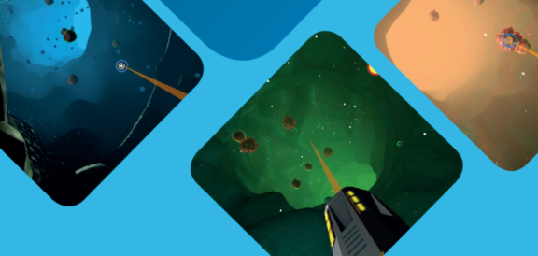
1. Acquiring data
Creating needed computer software:
3) for Virtual Reality and oncology patients(Czub, Piskorz, & Kowal, in preparation)
Source: own.
Source: own.

Slide 10
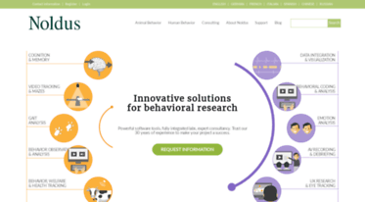
2. Creating databases and 3. analyses
Noldus
Source: https://www.noldus.com/

Slide 11
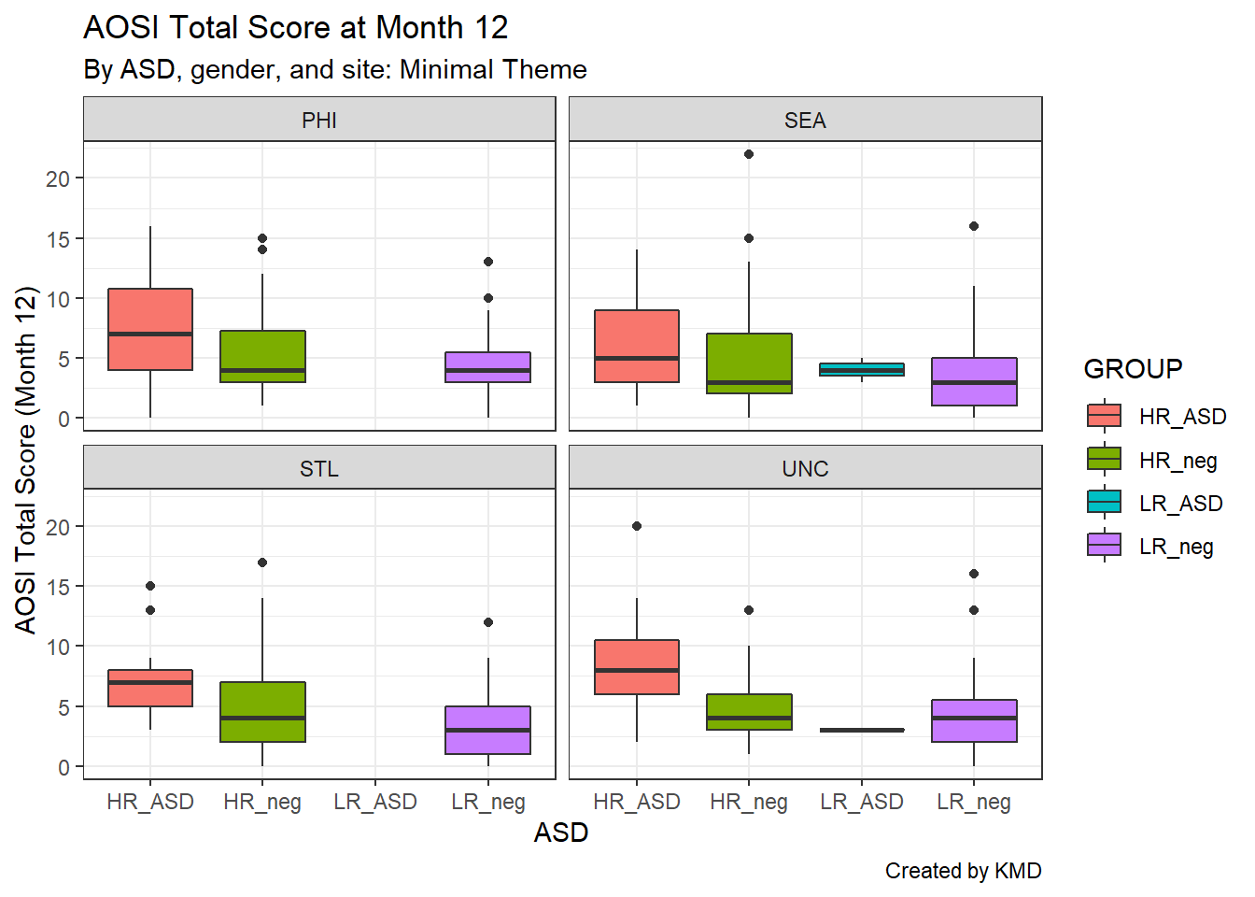
4. Presenting data
Graphical design
Source: https://bookdown.org/kdonovan125/ibis_data_analysis_r4/creating-graphs-with-ggplot2.html

Slide 12
Study Case
Let’s focus on an examplary study

Slide 13
What was our study aim?
To help children in a difficult, hospital situation.
Source: Public copyright license

Slide 14
How do we want to achieve that?
By examining parents’ time perspective.
Source: Public copyright license

Slide 15
Let’s get back to the beginning…
are pretty stressed during a hospitalisation.
All of us*
Children

Slide 16
Let’s get back to the beginning…
So…
Parents usually assist their children.
Source: Public copyright license

Slide 17
Let’s get back to the beginning…
But…
What if parents behavior doesn’t help.
Source: Public copyright license

Slide 18
Studies on parents’ behavior
But…
What if parents behavior increases child’s fear?
Source: Public copyright license

Slide 19
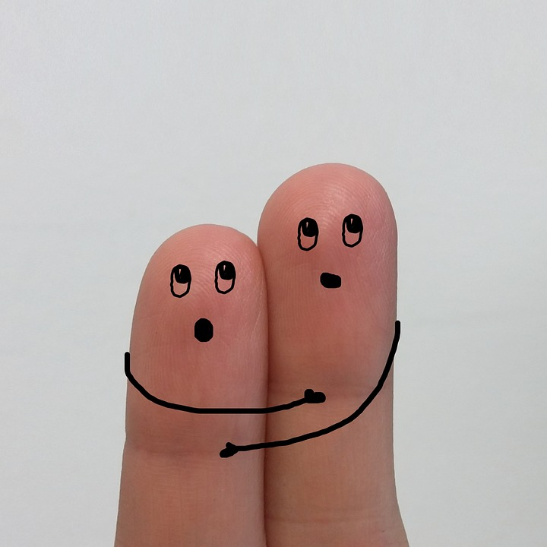
Studies on parents’ behavior
If parents, for instance, reassure their children that everything’s gonna be ok, children’s anxiety, in fact, increases (Manimala et al., 2000; McMurtry et al., 2006).
Source: Public copyright license

Slide 20
Studies on parents’ behavior
On the other hand, when parents use distraction techniques, promote coping strategies, or use humor directed to children…
Source: Public copyright license
Their offsprint begin to feel more calm (Chorney et al., 2009)

Slide 21
So the strategy should be….
To teach parents how to truly
support their children!
Source: Public copyright license

Slide 22
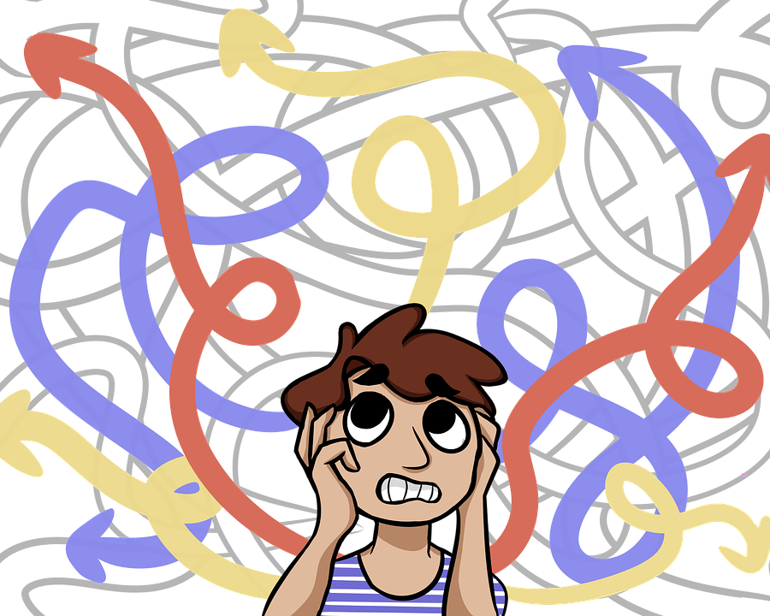
The main problem
How can we know parents’ behavior in a difficult, hospital situation beforehand?
Source: Public copyright license

Slide 23
Our answer
TIME PERSPECTIVE!
(Zimbardo et al., 1999)
Source: Public copyright license
Source: Public copyright license

Slide 24
What is time perspective?
Zimbardo’s idea that our perception of time influences our emotions, thoughts, and behaviors.
Source: http://www.evolutionofpsychotherapy.com/speaker/philip-zimbardo/

Slide 25
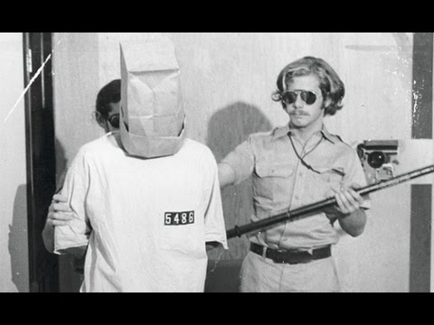
Philip Zimbardo
A professor at Stanford University and (probably best know as) a creator of The Stanford Prison Experiment
Source: https://www.simplypsychology.org/zimbardo.html

Slide 26
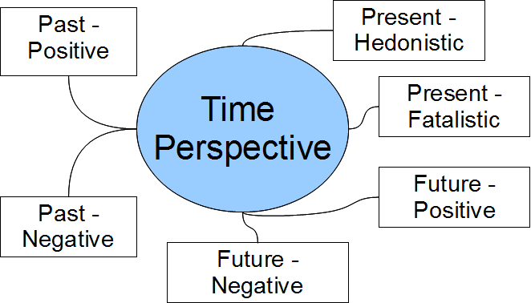
What is a time perspective?
Zimbardo’s approach towards perception of time
Source: https://en.wikiversity.org/wiki/File:TUSSTMQ9_StructuralModel_TimePerspective.png

Slide 27
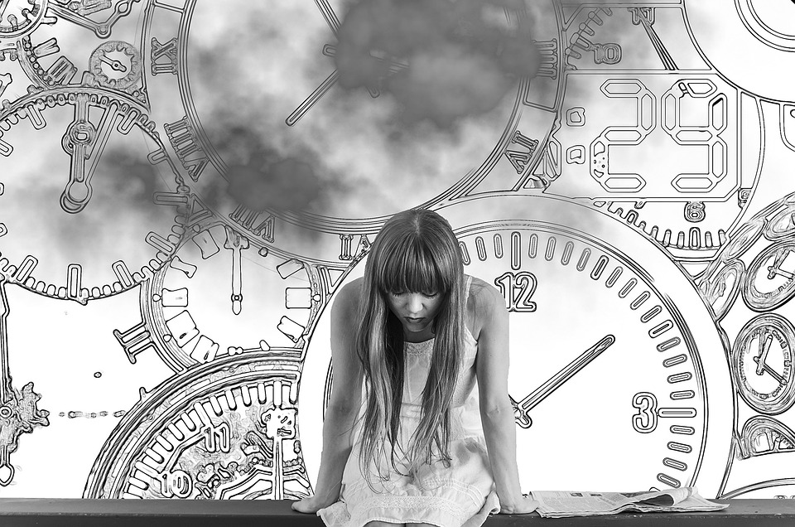
Coming back to our study…
We hypothesized that parents’ time perspective (i.e. whether a parent is focused on e.g. negative or positive aspects of the future) will be a predictor of parents’ behavior in the hospital.
Source: Public copyright license

Slide 28
So, we have a question…
And how to find an answer?
…
Study’s methodology

Slide 29
Methodology
Measure the time perspective of parents’ whose children are undergoing a hospital operation
Record parents’ behavior right before children’s anesthesia
Keep a track of children’s recovery

Slide 30
Methodology
Main problem?

Slide 31
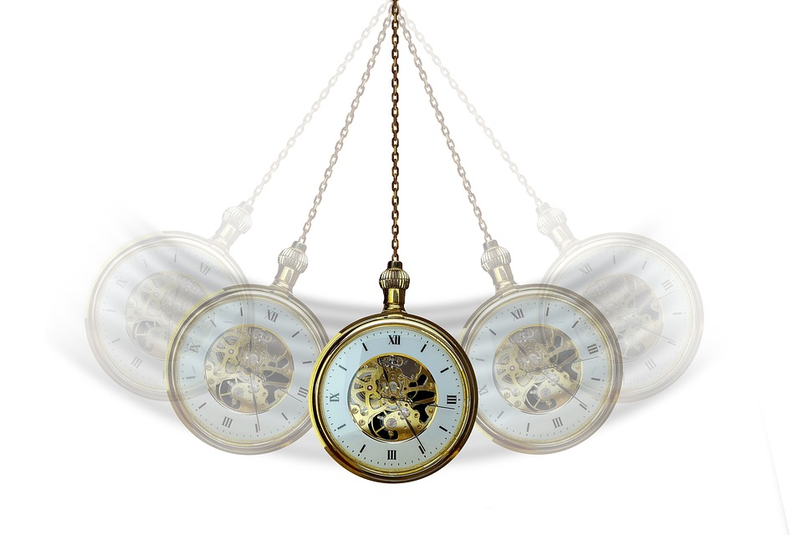
Main problem?
(except for persuading parents to participate in the study)*
Source: Public copyright license

Slide 32
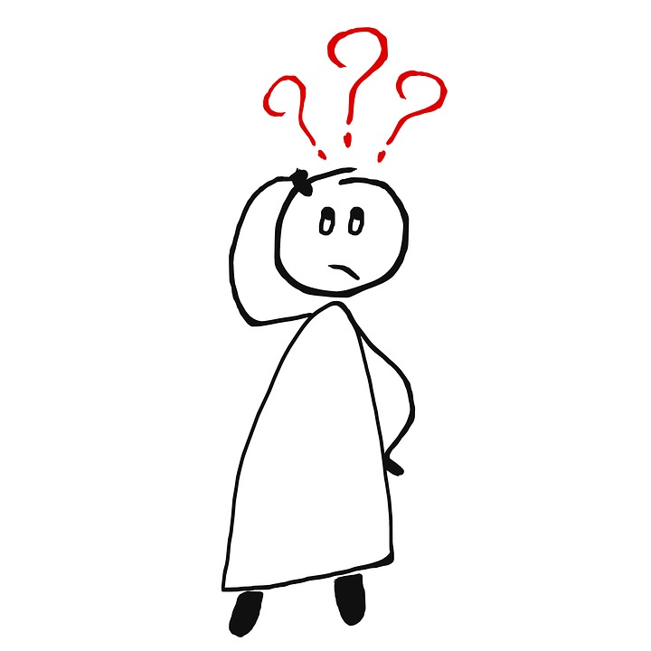
Main problem?
How to record, code, and analyse parents’ and children’s behavior?
Source: Public copyright license

Slide 33
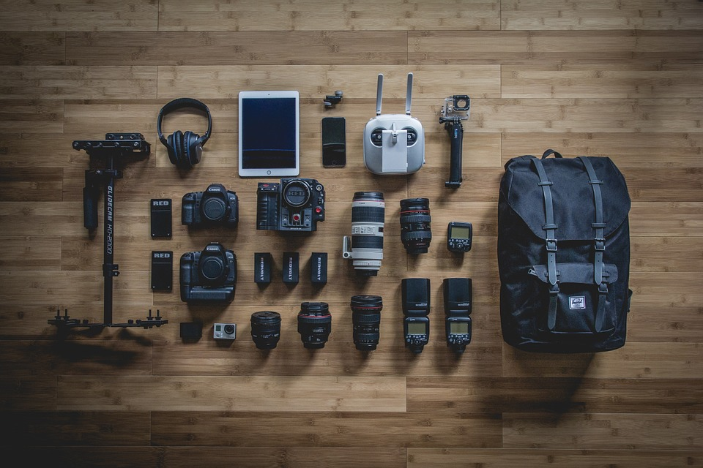
Solution
Modern technologies
Source: Public copyright license

Slide 34
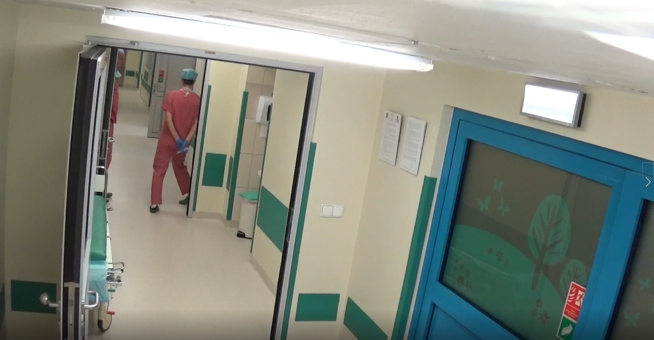
Capturing behavior
Using two hidden cameras*, placed at the hospital’s corridor.
1)
Source: own materials.

Slide 35
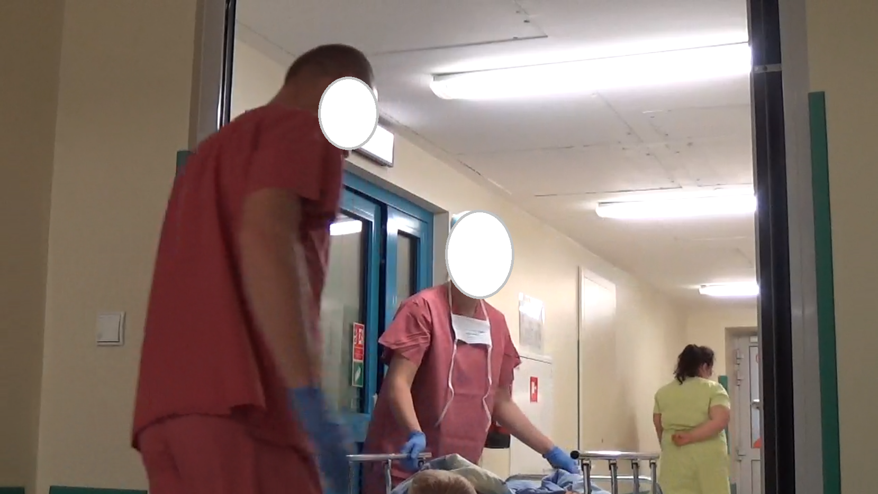
Capturing behavior
Using two hidden cameras*, placed at the hospital’s corridor.
2)
Source: own materials.

Slide 36
Coding behavior - PCAMPIS-R
Child Neutral Behaviors (CN)
Child Informs About Status
Child Coping Behaviors (CB)
Making Coping Statement
Nonprocedural-Related Talk by the Child
Audible Deep Breathing
Humor by the Child
Child Distress Behaviors (DB)
Crying ; Screaming
Verbal Resistance
Emotional Support
Verbal Fear
Verbal Emotion
Information Seeking
Adult Neutral Behavior (AN)
Humor Directed to Adults
Nonprocedure-Related Talk to Adults
Procedure-Related Talk to Adults
Command to Engage in Procedural Activity
Checking Childs Status
Commands for Managing Childs Behavior
Praise
Adult Coping Promoters (CP)
Humor Directed to Child
Nonprocedure-Related Talk to Child
Command to Engage in Coping Strategy
Adult Distress Promoters (DP)
Criticism
Reassuring Comment
Giving Control to the Child
Apology
Empathy

Slide 37
Further strategy?
So we have recorded the behavior, we have the main observational protocol… so what is next?

Slide 38
Coding behavior
Observer XT (Noldus Company)
Observer is a computer software that allows to play previously recorded videos and code them, by asigning behaviors to defined clusters.
Source: https://www.biogenet.pl/Badania-na-zwierz-tach/noldus.html

Slide 39
Observer XT
So… there is a software that will analyze behavior of subjects depicted in a recorded video automatically??
Source: Public copyright license

Slide 40
Observer XT
No…
:(
Source: Public copyright license

Slide 41
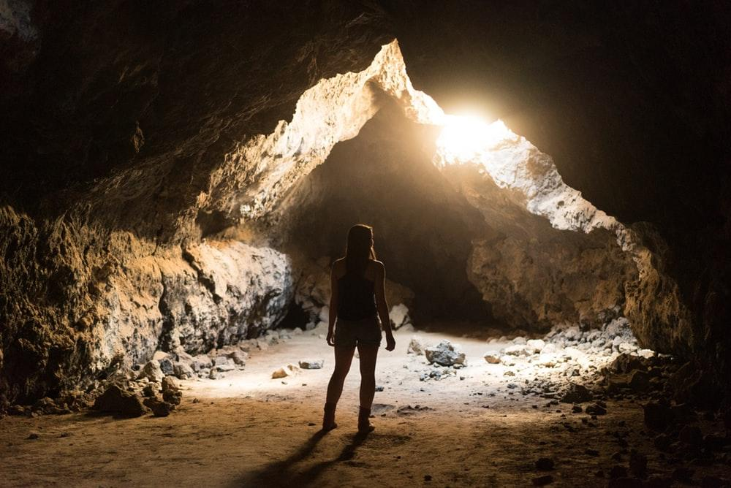
Observer XT
But…
Source: Public copyright license

Slide 42
Observer XT
It will definitely help and make the whole process a lot easier!
Source: Public copyright license

Slide 43
Observer XT
How does it work?
Case study

Slide 44
Results (so far…)
Parents’ behaviors that promoted coping strategies (e.g. humor directed to child, or commands to use coping strategy) were positively associated with child’s coping behaviors (e.g. nonprocedural-related talk by the child, or humor);
Parents’ behaviors that promoted distress (e.g. criticism or reassuring comments) were positively linked to child’s distress behaviors (e.g. crying or screaming);
Parents’ neutral behaviors (e.g. nonprocedural-related talk with other adults or checking child’s status) were positively related to child’s neutral behaviors (e.g. child informs about status).

Slide 45
Conclusion
We conclude that there is a strong relation between parents’ and children’ behavior, and we intend to further examine whether parents’ time perspective affected how the parents were behaving in a difficult, peri-operational situation.

Slide 46
Take-home message
If you want to analyze someone’s behavior… there is a lot of work in front of you ;-)
Source: Public copyright license
Source: Public copyright license

Slide 47
Take-home message
But, at the end, you will be most likely satisfied with the results!
Source: Public copyright license

Slide 48
Thank you for your attention!
Marta Kowal

Slide 49
Please, feel free to ask any questions.
Marta Kowal
marta7kowal@gmail.com

Slide 50
Literature
Chorney, J. M., & Kain, Z. N. (2009). Behavioral analysis of children’s response to induction of anesthesia. Anesthesia & Analgesia, 109(5), 1434-1440.
Czub, M., & Kowal, M. (2019). Respiration Entrainment in Virtual Reality by Using a Breathing Avatar. Cyberpsychology, Behavior, and Social Networking, 22(7), 494-499.
Manimala, M. R., Blount, R. L., & Cohen, L. L. (2000). The effects of parental reassurance versus distraction on child distress and coping during immunizations. Children's Health Care, 29(3), 161-177.
McMurtry, C. M., McGrath, P. J., & Chambers, C. T. (2006). Reassurance can hurt: Parental behavior and painful medical procedures. The Journal of Pediatrics, 148(4), 560-561.
Zimbardo, P. G., Keough, K. A., & Boyd, J. N. (1997). Present time perspective as a predictor of risky driving. Personality and Individual Differences, 23(6), 1007-1023.

