Slide 1
Title: Do Satisfied IT users - supervisors and subordinates manifest organizational citizenship behaviour at work? Possible applications in engineering studies programs MACICT Project 2018-2022 Alicja Keplinger, University of Wroclaw, Poland Jolanta Kowal, University of Wroclaw, Poland – MACICT Project
Faculty of
Historical and Pedagogical Sciences Institute of Psychology, Poland
,
The workshop presented during the INternational Conference ICTM 2019 and during the 2nd MACICT Meeting
Wrocław, 23-25 October 2019
7th International Conference on ICT Management for Global Competitiveness and Economic Growth in Emerging Economies ICTM 2019
Wroclaw, Poland, October 21-23, 2019
Notes:
The topic addresses the issue of organizational citizenship behavior at work manifest by IT users (it means the positions: supervisors and subordinates) in the context of job and life satisfaction. The results of IT Users will be analyzed by comparison to supervisors and subordinates - IT Users.
This project is concerned with position differences in the used of ethical patterns of behavior connect OCB and satisfaction of the life and job.
‹#›

Slide 2
The Goals of This Study
The aim of the article is to describe how professional position and level of life satisfaction (LS) affect organizational citizenship behavior (OCB) among IT users in Poland, the country which is an example of a transition economy. .
The dependent variable is OCB containing two dimensions: interpersonal orientation (OCBI) and organizational orientation (OCBO).
Two independent qualitative variables were distinguished:
professional position (supervisor - Psup, subordinate - Psub) and
life satisfaction (LS) - satisfaction from personal life (SPL) and satisfaction of job (SJ).
It is assumed that satisfied IT users - supervisors and subordinates percept and manifest organizational citizenship behaviour at work.

Slide 3
Overview
Introduction
Satisfaction
Ethical behavior – Organizational Citizenship Behaviours (OCB)
Position
IT Users
Research Questions and Hypotheses
Methodology
Results
Discussion
Conclusions
Limitations and Directions for Future Research
‹#›

Slide 4
Introduction
Much of the blame for the economic downturn occurring over the past several years has centred around organizations plagued by unethical leadership and behaviours.
(Kacmar, K.M., Andrews, M.C., Harris, K.J., Bennett J. Tepper, B.J., 2013).
As a result, both supervisors and subordinates employed have demonstrated a strong interest in promoting ethical behaviour in organizations.
(Kacmar, K.M. et al., 2013; Kowal, J. and Roztocki, N., 2015, Keplinger, A. et al., 2016)

Slide 5
Satisfacion
In essence, job satisfaction is frequently defined as the emotional-affective response of the employees to the job (Spector 1985).
Workers who have a high level of job satisfaction generally love their job; they feel justice in an environment in which they work, and feel that their job gives them some positive features such as variety, challenge, good pay and security, autonomy, pleasant co-workers, etc.
Workers who are happy at work will even devote private time to their work activities, they will be creative and committed, they will seek a way to cross any obstacle which might exist in the realisation of their jobs, and they will assist their colleagues and superiors.
These workers will have extraordinary performance, and the companies with these kinds of workers will be successful.
Bakotić, D., 2016, Relationship between job satisfaction and organisational performance
‹#›

Slide 6
Position
Subordinate -An employee ranked below another employee in terms of seniority or office hierarchy.
http://www.businessdictionary.com/definition/subordinate.html; 14.10.2019
Supervisor/Superior/Boss - Supervisors are usually authorized to recommend and/or effect hiring, disciplining, promoting, punishing, rewarding, and other associated activities regarding the employees in their departments.
http://www.businessdictionary.com/definition/supervisor.html; http://www.businessdictionary.com/definition/boss.html; 14.10.2019
‹#›

Slide 7
Ethical behavior – OCB: Organizational Citizenship Behavior
OCB - behaviour, which is not covered by the formal job description, but usually facilitates the realization of tasks and support in enhancement of these behaviours in organizational settings.
OCB-I behaviour directed at specific individuals in the organization, such as courtesy and altruism
is not explicitly or indirectly recognized by the formal reward system
plays a vital role in the effective functioning of the organization (Organ, 1988)
OCB-O behaviour benefiting the organization without actions aimed specifically toward any organizational member or members. This behaviour includes:
giving prior notice regarding an absence from work or informally adhering to rules designed to maintain order.
Sources: Anderson, Williams, 1998, Bateman, Organ, 1983; Lee, Allen, 2002; Konovsky, Organ, 1996, Organ, 1997; Organ, Podsakoff, Mackenzie, 2006; Schnake, 1991, Keplinger et al., 2014; Kowal, Keplinger, 2015.
‹#›

Slide 8
IT users definition
work a minimum of 20 hours per week
can skillfully use hardware and software (created by the IT professionals)
but they do not create systems and programs themselves (Keplinger et. al 2014, Kowal & Keplinger 2015).
‹#›

Slide 9
Research questions
‹#›

Slide 10
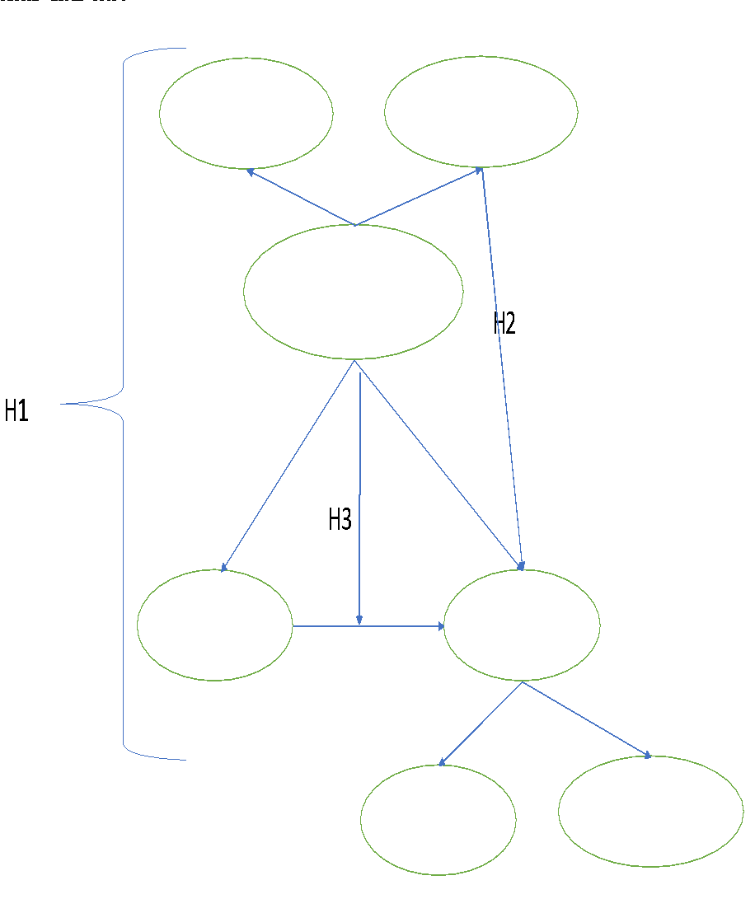
Fig. 1. Research Framework – Model And Hypotheses
H1: There are the dependencies between global life satisfaction, position (superiors and subordinates) and OCB among IT users.
H2: Job satisfaction of IT users has an effect on the levels of the OCB (OCB-I and OCB-O).
H3: It can we observed the impact of the interaction between professional position and job satisfaction on OCB (OCB-I and OCB-O). JS can be the moderator of relations: Position - OCB
‹#›

Slide 11
Methodology
Tools – adaptations of two questionnairs:
OCB (OCBI and OCBO) – dependent variables
Life Satisfaction questionnaire (Job Satisfaction, and Individual – private Life Satisfaction) – independent variables, moderators
Position – independent variable
Sample construction
Statistical methods
Questionnaires adaptation
‹#›

Slide 12
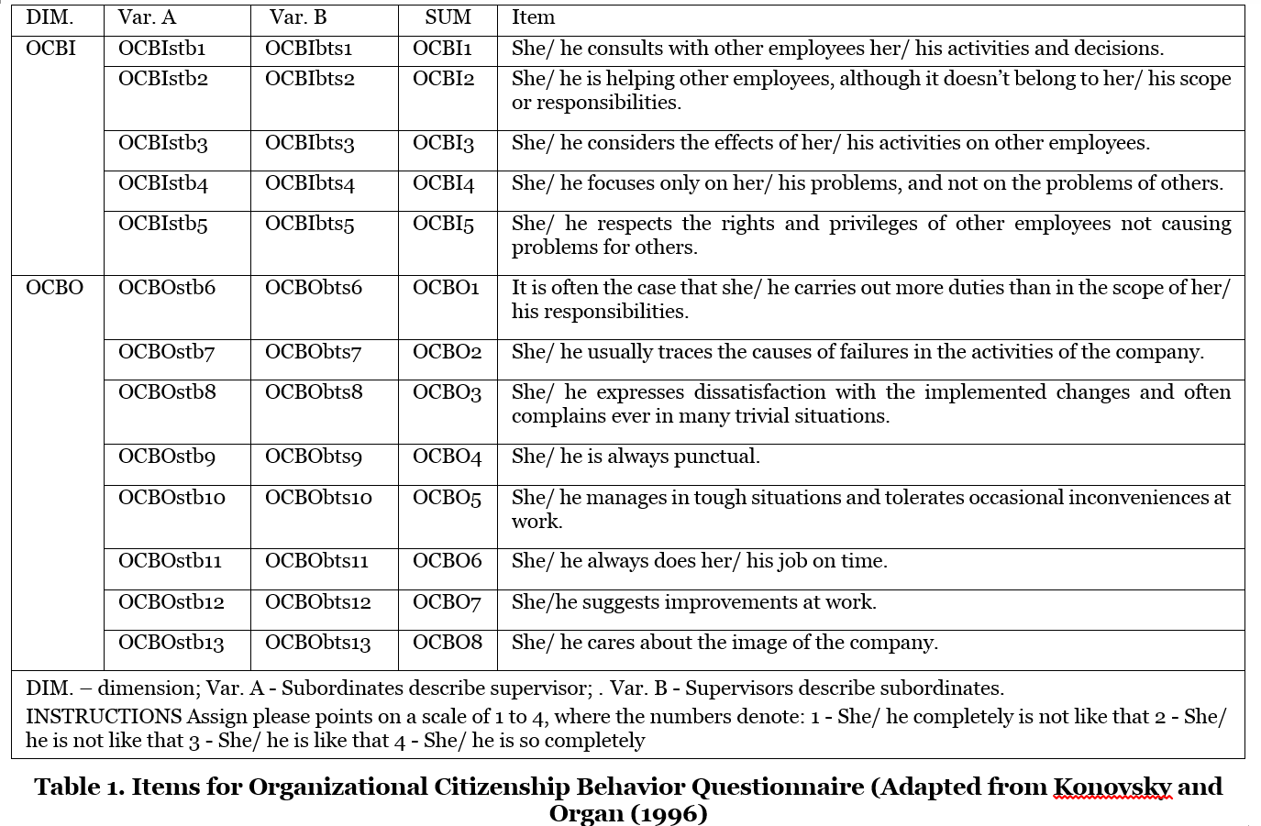
Table 1. Items for Organizational Citizenship Behaviours (OCB)
‹#›

Slide 13
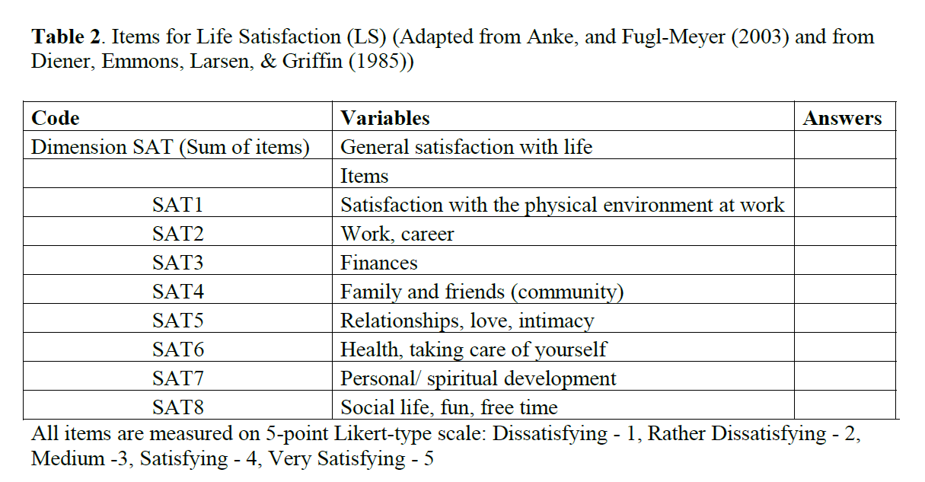
Table 2. Items for Life Satisfaction (LS) (Adapted from Anke, and Fugl-Meyer (2003) and from Diener, Emmons, Larsen, & Griffin (1985)
JS
LS
‹#›

Slide 14
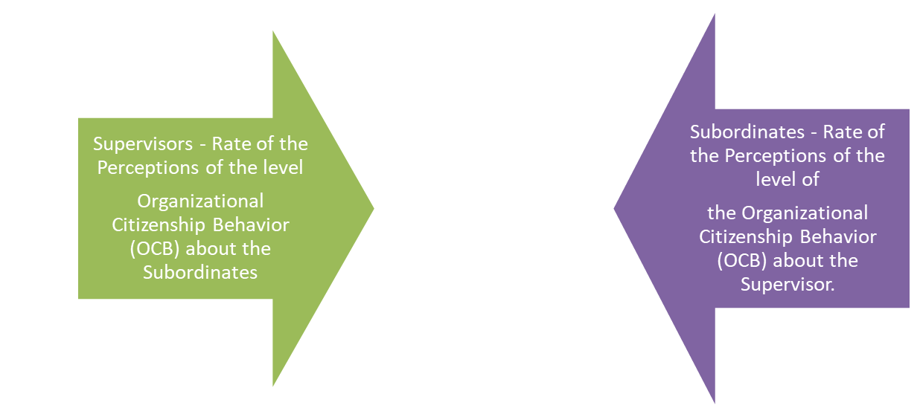
Sample Characteristics of IT Users in Both Countries
Participants and data collection. The trials construction included the methods of random interpersonal network and sequence sampling with the passive optimal experiment design in Poland (Kowal and Keplinger 2019).
The study was carried out in 2016-2019 in a group of 280 IT Users in Poland. The research was conducted by means of an online survey based on our own adopted tools: The OCB Questionnaire and The Life Satisfaction Questionnaire.
Category | Quantity | Percent
Supervisor | 91,00 | 32,50
Subordinate | 189,00 | 67,50
Total | 280,00 | 100,00

Slide 15
Statistical methods
For all questions measuring LS was applied from the 5-point Likert scale: 1 means “I strongly disagree,” and 5 “I strongly agree.”
For all questions measuring OCB was applied from the 4-point Likert scale: 1 - She/ he completely is not like that, 2 - She/ he is not like that, 3 - She/ he is like that, 4 - She/ he is so completely.
The statistical methods were chosen appropriately to measuring variables’ scales. They comprised the descriptive statistics, the point estimation, the section estimation, the statistical hypotheses verification and multivariate analysis as ANOVA, CFA, EFA, AVE, SEM. MANOVA, multivariate analysis of variance, regression approach.
‹#›

Slide 16
The adaptation process

Slide 17
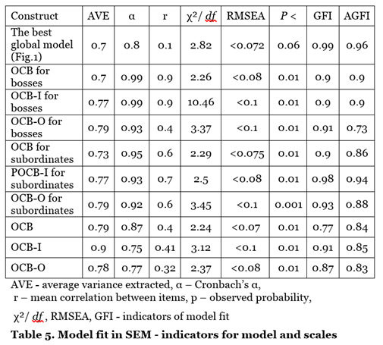
OCB, Global Model – Scales Discriminant Power (AVE, EFA), Reliability (Cronbach’s α) Analysis, and Validity (CFA)
Analytical methods used in the process of validation comprised the method of competent judges, items discriminatory power, scales validity (CFA) and reliability (Cronbach’s α) analysis.To measure the discriminant validity of the construct the authors apply the Average Variance Extracted (AVE) method, in order to examine whether the amount of variance explained by the construct in relation to the amount of variance due to the measurement error is significant. The conceptual model was confirmed by SEM analysis.
‹#›

Slide 18
The correlations concerning sample of IT Users in dimensions of OCB (OCBI, OCBO), Position, Satisfaction (JS, LS) (significance with p<0.05)
Independent variables | OCBI | OCBO | OCB
Position | 0,10 | 0,08 | 0,13
Job satisfaction | 0,25 | 0,24 | 0,29
Individual life satisfaction | 0,18 | 0,13 | 0,19
Global life satisfaction (JS+Lslife) | 0,28 | 0,24 | 0,31
INT_POS_GLLS - interaction of position and global life satisfaction | 0,25 | 0,25 | 0,29
INT_SJOB_POS - interaction of position and job satisfaction | 0,21 | 0,22 | 0,25
INT_LS_POS - - interaction of position and private - individual satisfaction | 0,18 | 0,08 | 0,17
Int_LSJOB_LSLIFE - interaction of job satisfaction and life satisfaction | 0,27 | 0,24 | 0,31
Results

Slide 19
Overview of Results
Hypothesis | Supported | Comments
1 | Yes | There are the dependencies between life satisfaction, position (superiors and subordinates) and OCB among IT users.
2 | Yes | Job satisfaction of IT users has an effect on the levels of the OCB (OCB-I and OCB-O).
3 | Yes | It can we observed the impact of the interaction between professional position and the dimensions of satisfaction on OCB (OCB-I and OCB-O).
Our hypotheses concerned with Position, Satisfaction (JS and LS) and OCB (OCBI and OCBO) are confirmed.
‹#›

Slide 20
Both superiors and subordinates assess each other similarly in terms of manifesting OCB, OCBI and OCBO at a medium high level.
Conclusion 1
‹#›

Slide 21
Life satisfaction, position and OCB
Satisfied subordinates who see that their superiors are demonstrating OCB, they tend to behave similarly. It can be concluded that they take the example from superiors.
In the group of superiors, life satisfaction differentiates the overall level of OCB and OCBI but does not determine the level of OCBO.
More satisfied from life, superiors see on their subordinates civic behaviour, especially those oriented to on people, for example, mutual help.
Our research reveals a lack of relationship between the satisfaction of superiors' life and their perception OCBO among subordinates
Conclusion 2
‹#›

Slide 22
Job satisfaction, position and OCB
The superiors in our group are moderately satisfied with their work. People dissatisfied with work did not appear among the superiors.
Most subordinates are moderately satisfied with their work. In the group of employees' subordinates there is a similar percentage of dissatisfied and very satisfied employees.
Levels of job satisfaction of subordinates differentiate their perception of organizational behaviour among superiors in the field of OCB, OCBI, and OCBO.
We observed that among promoted people there are no employees who are completely dissatisfied. Among them, the level of satisfaction is at least average. Most superiors obtained a moderately high level of job satisfaction in the study, as did subordinates.
Superiors very satisfied with work compared to moderately satisfied more often perceive OCB among their subordinates.
Conclusion 3
‹#›

Slide 23
Interactions and OCB
There is a moderation of the relationship of position and OCB, OCBI and OCBO with regard to job satisfaction. One can observe the impact of the interaction between professional position and job satisfaction on OCB, OCBI, OCBO. The bosses who are very satisfied with their work most often see in their subordinates the manifestations of OCB, OCBI, OCBO. Subordinates with the highest degree of job satisfaction more often see OCB, OCBI, OCBO at their bosses.
Our research finds that there is significant interaction, and therefore moderation, between the variables: position and life satisfaction with OCBI and OCBO as well as OCB. Compared to all the analyzed groups, bosses achieving a high level of life satisfaction show the highest average of value in perception of OCBI, OCBO also OCB type behaviours in general. It means that for life satisfied bosses the most percept the good examples of behaviour of their subordinates against the background of other bosses.
Conclusions 4
‹#›

Slide 24
Discussion
Our findings are compatible to results of Kowal and Roztocki (2015a, 2016), who claimed that Polish IT professionals are rather pessimistic as far as organizational ethics is concerned and and have reached the low level of trust each other.
Similar conclusions were emphasized by Keplinger et el. (2014a), Kowal and Keplinger (2015), who observed rather medium or worse OCB among IT users in Poland.
Maybe this pessimistic effect of ethical aspect of behaviour can be related to mobbing and professional burnout of IT users in Poland, concerned with unemployment and uncertainties jobs (Kowal and Gurba 2015, 2016).
Generally the evaluation of OCB and its subscales are rather low.
Probably it can be caused by the fact that Poland is in transition process from centrally planned economy where usually dominated authocratic leadership or style of management, and OCB don’t correlate strongly with moral and ethical aspects in the context of socio-economic processes (Kowal, Roztocki, 2013, 2015, Keplinger et al., 2016).
‹#›

Slide 25
Originality / value
The presented research fills a gap in the area of observation and description of the characteristics of IT users who are in the labour market.
Research shows the significant role of shaping ethical behaviour in the work environment in the social and economic, especially management human resources context.
In the light of our knowledge, the novelty of our research is the achieve interesting result about the bosses who achieve a high level of life satisfaction, and who the most percept good formes of the behaviour of subordinates. In Poland (it means the example of the country of transition economy) this result is important because you find here rather a harsh and impersonal approach to subordinates.
Ethical emotions, e.g. satisfaction from life are related to ethical behaviour on a daily basis.
‹#›

Slide 26
Contribution, limitations and next step
Contribution:
The results of our study may be addressed to users and professionals, especially HR staff, managers in transition economies, teachers.
Applying our conclusions may improve social and economic work results.
Applying and popularizing the ideas of OCB may be a factor of development of Information System staff because ethical attitudes and behaviors increase: commitment, efficiency, economic growth.
We hope that our research presented in this paper will inspire other researchers to conduct their own research on this interesting topic.
The limitations of current studies concern:
Research should be continued on more numerous people. Studies could be continued in the other transition and developed countries for more numerous research samples.
Next step of our research could be the examination of the psycho-social mechanism responsible for ethical aspects of behavior at work.
‹#›

Slide 27
Thank you!
We are open for questions
Alicja Keplinger | Jolanta Kowal
alicja.keplinger@uwr.edu.pl | jolanta.kowal@uwr.edu.pl
‹#›

