Slide 1
Faculty of
Historical and Pedagogical Sciences Institute of Psychology, Poland
,
Title: European standards and guidelines for internal quality assurance within higher education institutions Possible applications in engineering studies programs MACICT Project 2018-2022 Jolanta Kowal, University of Wroclaw, Jarosław Klebaniuk, University of Wroclaw, Małgorzata Sobol-Kwapińska, University of Wroclaw, Poland
MACICT Project 2018-2022
Wroclaw, Poland 2020
Notes:
‹#›
.
‹#›

Slide 2
The G1.1 Policy and procedures for quality assurance: Goals of This Study
Institutions should have a policy and associated procedures for the assurance of the quality and standards of their programmes and awards.
They should also commit themselves explicitly to the development of a culture which recognises the importance of quality, and quality assurance, in their work.
To achieve this, institutions should develop and implement a strategy for the continuous enhancement of quality. The strategy, policy and
procedures should have a formal status and be publicly available.
They should also include a role for students and other stakeholders.
Notes:
‹#›
‹#›

Slide 3
Summary list of European standards for quality assurance
This summary list of European standards for quality assurance in higher education is drawn from Chapter 2 of the report and is placed here for ease of reference.
The standards are in three parts covering:
internal quality assurance of higher education institutions,
external quality assurance of higher education, and
quality assurance of external quality assurance agencies.
‹#›
Notes:
‹#›

Slide 4
1.2 Approval, monitoring and periodic review of programmes and awards: Overview
Institutions should have
formal mechanisms for the approval,
periodic review and
monitoring
of their programmes and awards.
‹#›
Notes:
‹#›
‹#›

Slide 5
1.3 Assessment of students:
Students should be assessed using
published criteria,
regulations and
procedures
which are applied consistently.
Notes:
‹#›
‹#›

Slide 6
1.4 Quality assurance of teaching staff:
Institutions should have ways of satisfying themselves that
staff involved with the teaching of students are qualified and competent to do so.
They should be available to those undertaking external reviews,
and commented upon in reports.
‹#›
Notes:
‹#›

Slide 7
1.5 Learning resources and student support:
Institutions should ensure that
the resources available
for the support of student learning are
adequate and
appropriate
for each programme offered.
‹#›
Notes:
‹#›
‹#›

Slide 8
1.6 Information systems:
Institutions should ensure that
they collect,
analyse and
use relevant information
for
the effective management
of their programmes of study
and other activities.
‹#›
Notes:
‹#›
‹#›

Slide 9
1.7 Public information:
Institutions should
regularly publish
up to date,
impartial and
objective information,
both quantitative and qualitative,
about
the programmes and
awards they are offering.
‹#›
Notes:
‹#›
‹#›

Slide 10
Part 2: European standards for the external quality assurance of higher education
2.1 Use of internal quality assurance procedures:
External quality assurance procedures should take into account
the effectiveness of the internal quality assurance processes described in Part 1 of the European Standards and Guidelines.
‹#›
Notes:
‹#›
‹#›

Slide 11
2.2 Development of external quality assurance processes
The aims and objectives of quality assurance processes should be determined
before the processes themselves are developed,
by all those responsible (including higher education institutions) and
should be published with a description of the procedures to be used.
‹#›
Notes:
‹#›
‹#›

Slide 12
2.3 Criteria for decisions:
Any formal decisions made as a result of an external quality assurance
activity should be based on explicit published criteria that are applied consistently.
‹#›
Notes:
‹#›

Slide 13
2.4 Processes fit for purpose:
All external quality assurance processes should be designed specifically
to ensure their fitness to achieve the aims and objectives set for them.
‹#›
Notes:
‹#›

Slide 14
2.5 Reporting:
Reports should be published and should be written in a style, which is clear and readily
accessible to its intended readership.
Any decisions, commendations or recommendations contained in reports
should be easy for a reader to find.
‹#›
Notes:
‹#›

Slide 15
2.6 Follow-up procedures:
Quality assurance processes which contain recommendations for action or
which require a subsequent action plan, should have a predetermined follow-up procedure which is
implemented consistently.
‹#›
Notes:
‹#›

Slide 16
2.7 Periodic reviews:
External quality assurance of institutions and/or programmes should be undertaken
on a cyclical basis.
The length of the cycle and the review procedures to be used should be
clearly defined and
published in advance.
‹#›
Notes:
‹#›

Slide 17
2.8 System-wide analyses:
Quality assurance agencies should produce from time to time summary
reports describing and analysing the general findings of their reviews, evaluations, assessments etc.
‹#›
Notes:
‹#›

Slide 18
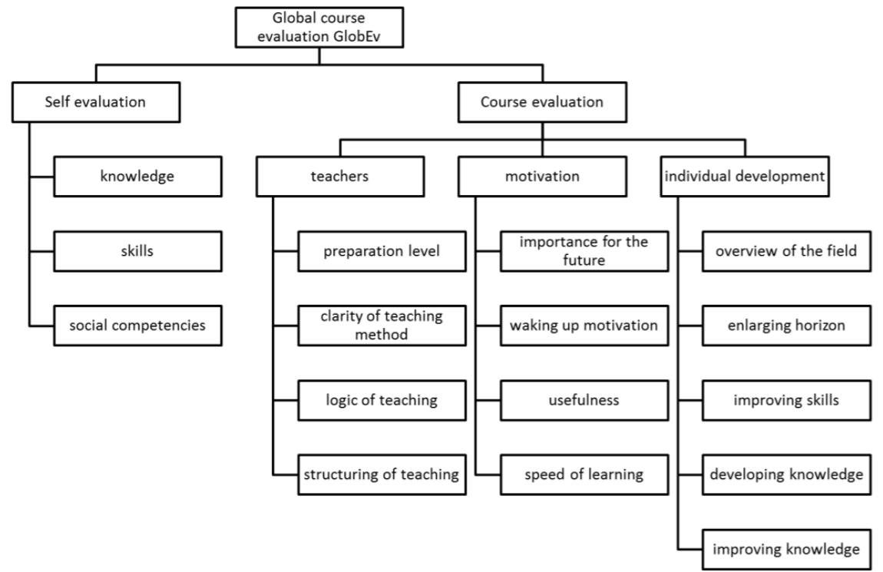
Course evaluation scheme according to this rules
Mäkiö et al. 2019
‹#›
Notes:
‹#›

Slide 19
Eight principles of effective teaching
Eight ideas from cognitive psychology that you should think about putting into your teaching.
‹#›
Notes:
‹#›

Slide 20
Set of principles
Tom Sherrington has put together a really useful (and practical) set of principles, Shaun Allison and Andy Tharby make a powerful case for six key focuses, and researchers such as Rosenshine have brought together research-based insights on instruction.
‹#›
Notes:
‹#›

Slide 21
Eight ideas
Eight ideas coming mainly from cognitive psychology summarised by Ruth Powley for the Optimus Education Knowledge Centre.
You can check out the original article here and get some resources for embedding it with the mastery lesson plan and Ruth’s webinar on developing pupils’ memory.
‹#›
Notes:
‹#›

Slide 22
Effective teaching
It’s important that we understand what makes effective teaching. A 2014 survey found that as many as 90% of teachers thought that individuals learn better in their preferred learning style – despite the lack of any evidence to support this. At the same time many effective techniques are underused.
So what should we focus on?
‹#›
Notes:
‹#›

Slide 23
1. Develop mastery learning
Rosenshine’s research on effective teaching advocates ‘mastery learning’ which builds automatic fluency in key concepts. He recommends:
beginning lessons with a 5-8 minute review of previous learning
presenting new material in small steps with student practice after each step (Evertson et al., 1980)
limiting the amount of material students receive at one time – reviewing is as important as new content (Miller, 1956; Laberge & Samuels, 1974; Samuels, 1994)
re-teaching material when necessary.
Find out more about why students’ performance doesn’t always mean that they have mastered learning in a video from Robert Bjork.
‹#›
Notes:
‹#›

Slide 24
2. Don’t dismiss knowledge as ‘lower order’
What Makes Great Teaching states that ‘the most effective teachers have deep knowledge of the subjects they teach.
’ Rosenshine found that ‘one characteristic of effective teachers is their ability to anticipate students’ errors.’
Deep knowledge is vital to achievement: breadth of knowledge is one of the key influencing factors for academic attainment.
Deep knowledge is also vital to memorising and thinking. Cognitive scientists such as Daniel Willingham have found that a memory replete with facts learns better than one without (Willingham, 2014; Dunlosky et al., 2013)
Learn more about Powerful Learning
‹#›
Notes:
‹#›

Slide 25
3. Expect excellence from all
Shaun Allison, Deputy Headteacher of Durrington High School, writes that ‘all, most, some’ learning objectives ‘stifle aspirations of what students can achieve.’
Think in terms of expected learning gains:
what deep understanding or technical proficiency will students gain mastery of?
what will excellence look like?
set a single, challenging objective for all students with appropriate scaffolding.
‹#›
Notes:
‹#›

Slide 26
4.1 Guide learning
What Makes Great Teaching recommends ‘reviewing previous learning, providing model responses for students [and] progressively introducing new learning (scaffolding).’
Rosenshine’s research shows that the most successful teachers spent more than half of the class time lecturing, demonstrating, and asking questions.
Cognitive scientists such as Kirschner also recommend guided practice: ‘When dealing with novel information, learners should be explicitly shown what to do and how to do it’.
‹#›
Notes:
‹#›

Slide 27
4.2. Rosenshine recommends:
He recommends worked examples over problem solving tasks.
Worked examples aid learning because they reduce working memory load
and focus on the essential relations between problems.
giving clear and detailed instructions and explanations
providing worked examples of problems or tasks
providing a number of examples.
‹#›
Notes:
‹#›

Slide 28
5. Ensure that students have to think hard
Coe says that
‘learning happens when people have to think hard’. Teachers should ask themselves questions like ‘Where in this lesson will students have to think hard?’.
Desirable difficulties which make short-term performance harder cause better long-term learning.
These include:
varying the conditions of practice
spacing practice sessions with gaps to allow forgetting
interleaving rather than blocking topics
using retrieval quizzes to test recall.
Find out more about desirable difficulties.
‹#›
Notes:
‹#›

Slide 29
6.1 Put deliberate practice into lessons
What Makes Great Teaching recommends giving adequate time for practice to embed skills securely. Practice of new learning should be spaced over at least three occasions.
This overlearning creates fluent understanding and transfers learning to the long-term memory.
Rosenshine found that the most effective teachers understood that ‘material will be forgotten unless there is sufficient rehearsal.’
His research also suggested that the optimal success rate in practice was 80%: students were learning but still challenged.
‹#›
Notes:
‹#›
‹#›

Slide 30
6.2 Rosenshine recommends:
providing a high level of active practice for all students
guiding students as they begin to practice
preparing students for independent practice
monitoring students when they begin independent practice to provide feedback and corrections.
‹#›
Notes:
‹#›

Slide 31
7. Test to improve learning
If long-term memory doesn’t change, it’s very difficult to say what has been learned.
Information should be ‘overlearned’ by 20% to optimise recall.
Dunlosky’s research recommends the following methods:
practice testing improves memory retrieval and is more effective than re-study or concept mapping when frequent, spaced and with feedback
spacing practice forces students to think harder and interleaving practice strengthens memory retrieval
elaborative interrogation enhances learning by integrating new information with prior knowledge
self-explanation helps students understand processes.
‹#›
Notes:
‹#›

Slide 32
8. Use questioning frequently and rigorously
What Makes Great Teaching recommends effective questioning, which require all students to process and rehearse material.
Rosenshine criticised ‘the least effective teachers [who] asked only nine questions in a 40-minute period.’
Rosenshine recommends:
Asking a large number of questions to check for understanding
‹#›
Notes:
‹#›

Slide 33
References
ESG_2015.pdf, https://enqa.eu/wp-content/uploads/2015/11/ESG_2015.pdf
https://enqa.eu/wp-content/uploads/2015/11/ESG_2015.pdf
European Association for Quality Assurance in Higher EducationEuropean Association for Quality Assurance in Higher Education, Standards and Guidelines for Quality Assurance in the European
Higher Education Area, Helsinki, Finland 2005
European Communities, 2006, GUIDELINES FOR PROJECT AND PROGRAMME EVALUATION
Tom Sherrington, 2016. Principles Of Effective Teaching, https://teacherhead.com/2016/01/10/principles-of-effective-teaching/
Shaun Allison and Andy Tharby, 2015. Six principles to support great teaching and learning Camarthen. United Kingdom: Crown House Publishing. ISBN10 1845909739
Barak Rosenshine, 2012. Principles of Instruction, Research-based Strategies that All Teachers Should Know, American Educator, Spring 2012
Owen Carter, 2016. Eight principles of effective teaching, https://blog.optimus-education.com/eight-principles-effective-teaching
Notes:
‹#›

Slide 34
References
Ruth Powley, 2016. Look Out For Learning. Available at: https://lookoutforlearning.wordpress.com/2016/01/18/8-catch-up-pedagogies-every-teacher-should-know/
Ruth Powley, Powerful pedagogy: Teach better quicker, January 2018, DOI: 10.4324/9781315226613
Owen Carter, 2016. Eight principles of effective teaching. Available at: https://blog.optimus-education.com/eight-principles-effective-teaching
Daniel Willingham, Science & Education, http://www.danielwillingham.com/
Rob Coe, 2016, Learning happens when you think hard. Available at: https://itilbury.wordpress.com/2016/01/20/learning-happens-when-you-think-hard-the-thinking-curriculum/
Coe, R. and Aloisi, C. and Higgins, S. & Major, L.E. (2014). What makes great teaching? Review of the underpinning research, Project Report. Sutton Trust: London.
Higgins, S., Kokotsaki, D. and Coe, R. (2011). Toolkit of Strategies to Improve Learning. Sutton Trust [online] Available at: http://www.cem.org/attachments/1toolkit-summary-final-r-2-.pdf.
J. Mäkiö, , S. Piashkun, , J. Kowal, M. Paasivaara, , E. Surkova (2019). FIT FOR THE FUTURE - MODERNISATION OF MASTER CURRICULUM IN ICT FOR ENHANCING STUDENT EMPLOYABILITY IN BELARUS, EDULEARN19 Proceedings, 9116-9122. DOI: 10.21125/edulearn.2019.2249
E. Mäkiö-Marusik, J. Mäkiö, and J. Kowal, "Validation of task-centric holistic agile approach on teaching cyber physical systems engineering," (December 30, 2017). GOSPODARKA RYNEK EDUKACJA = ECONOMY MARKET EDUCATION, 18(4), 2017, 5-17.
Agarwal, P. K., Bain, P. M., & Chamberlain, R. W. (2012). The value of applied research: Retrieval practice improves classroom learning and recommendations from a teacher, a principal, and a scientist. Educational Psychology Review, 24, 437–448. https://doi.org/10.1007/s10648-012-9210-2
‹#›
Notes:
‹#›

Slide 35
References
Dunlosky, J., Rawson, K.A., Marsh, E.J.,Nathan, M.J., Willingham, D.T. (2013). Improving Students' Learning With Effective Learning Techniques: Promising Directions From Cognitive and Educational Psychology. Psychological Science in the Public Interest, 14, 4–58. https://doi.org/10.1177/1529100612453266
Evertson, C. M., Anderson, C.W., Anderson, L. M., Brophy, J. E. (1980). Relationships Between Classroom Behaviors and Student Outcomes in Junior High Mathematics and English Classes. American Educational Research Journal, 17, 43–60. https://doi.org/10.3102/00028312017001043
Laberge, D. H. and Samuels, S. J. (1974).Toward a theory of automatic information processing in reading. Cognitive Psychology, 6, 293-323. https://doi.org/10.1016/0010-0285(74)90015-2
Miller, G. A. (1956). The magical number seven, plus or minus two: some limits on our capacity for processing information. Psychological Review, 63, 81–97. https://doi.org/10.1037/h0043158
Samuels, S. J. (1994). Toward a theory of automatic information processing in reading, revisited. In R. B. Ruddell, M. R. Ruddell, & H. Singer (Eds.), Theoretical models and processes of reading (p. 816–837). International Reading Association.
Willingham, D. T. (2014). Strategies That Make Learning Last, Educational Leadership, 72, 10-15.
‹#›
Notes:
‹#›

Slide 36
Links
https://twitter.com/powley_r
http://my.optimus-education.com/?utm_source=leadingcpd&utm_medium=blog&utm_campaign=teachingandlearning&sourcecode=XXXXBLXX1NAXX01CA
https://www.youtube.com/watch?v=gtmMMR7SJKw
http://my.optimus-education.com/?utm_source=leadingcpd&utm_medium=blog&utm_campaign=teachingandlearning&sourcecode=XXXXBLXX1NAXX01CA
http://gocognitive.net/interviews/dissociating-learning-performance
https://www.nature.com/nrn/journal/v15/n12/abs/nrn3817.html
http://gocognitive.net/interviews/dissociating-learning-performance
http://www.suttontrust.com/researcharchive/great-teaching/
https://www.scotthyoung.com/blog/2014/08/10/7-principles-learn-better-science/
http://www.memory-key.com/improving/strategies/study/elaborating
https://www.youtube.com/watch?v=gtmMMR7SJKw
http://www.memory-key.com/improving/strategies/study/elaborating
29.09.20

Slide 37
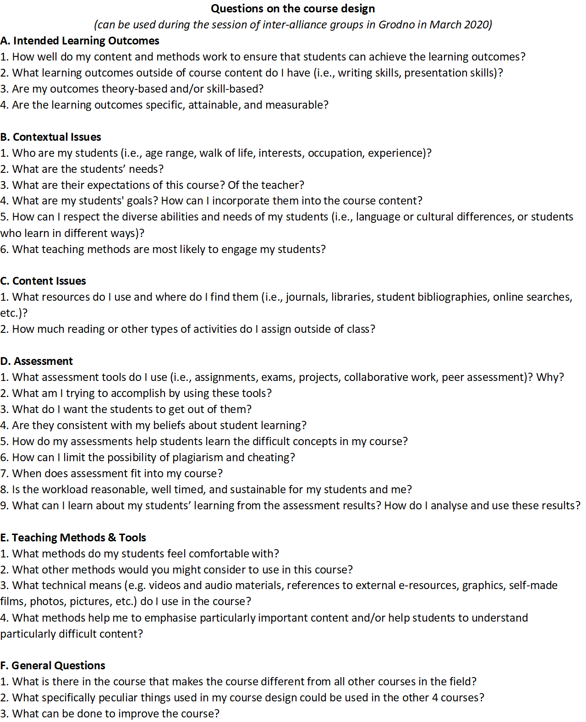
Attachment 1. Questions for Self-evaluation of the course design
From: Siarhei Piashun, 2019
‹#›
Notes:
‹#›

Slide 38
Appendix 2. Dimensions and items of the questionnaire – course evaluation by students
EFFECTS OF TEACHING - KNOWLEDGE | EF
I know the methods and tools of the subject. | EF1
I have knowledge on technics adequate to the subject. | EF2
I understand the fundamental problems of the subject. | EF3
I understand the basic definitions of the subject. | EF4
I have the feeling that I am able to compare and find significant associations in the field and I am able to formulate solutions using the methods of the subject. | EF5
I have the feeling that I am able to argue and evaluate the given problems and solutions of the topic self-evidently. | EF6
I am able to choose the adequate methods the types of problems of this field. | EF7
‹#›
Notes:
‹#›

Slide 39
Skills
SKILLS | SKILLS
I am able to use basic theoretical knowledge and practical skills in the subject. | Skill1
I can understand analyze phenomena and processes on the basis of the methods of the course. | Skill2
I am able to use the knowledge and skill gained during to analyze proposed solutions of concrete problems and propose new solutions using methodology, technics and tools of the course. | Skill3
I am able to introduce proposed solutions in similar projects. | Skill4
‹#›
Notes:
‹#›

Slide 40
SOCIAL COMPETENCIES
SOCIAL COMPETENCIES | SC
In my team the team members are able to properly formulate priorities that support the implementation and solving assumed task as a team. | SC1
In my team the team members elaborate in the group the algorithm of solving special tasks. | SC2
In my team the team members are able to cooperate and work in the group taking different roles during preparation common projects using methods technics and tools of the course. | SC3
In my team the team members are respectful to each other. | SC4
In my team the team members are helpful to each other. | SC5
I feel comfortable to share my time with my team members. | SC6
In my team I can openly talk about critical topics. | SC7
I spend time with my team members also in my free time. | SC8
In my team we openly speak also about private topics. | SC9
After the project is over, I would like to have another project with my team. | SC10
‹#›
Notes:
‹#›

Slide 41
EVALUATION OF THE COURSE
EVALUATION OF THE COURSE | EC
Organization
The course is well organized. | EC4
The course is well prepared. | EC5
The organization of the course in the classroom is optimal. | EC2
Teachers
In this course the learning is easy. | EC1
In this course the knowledge is given in a clear, interactive and understandable way. | EC3
In this course the teachers are well prepared. | EC6
The way of teaching is clear. | EC7
The way of teaching is logical. | EC8
The way of teaching is well structured. | EC9
‹#›
Notes:
‹#›

Slide 42
Motivation and satisfaction
Motivation and satisfaction
Generally, I feel satisfied with this course. | EC10
I would recommend this course to other students. | EC11
I have feeling to learn new things that are important for my future. | EC12
I am motivated to participate in this course. | EC13
I think the course is useful. | EC14
I have the feeling that in this course I am learning faster than in other courses. | EC15
I think the course prepare me for my later job. | EC16
‹#›
Notes:
‹#›

Slide 43
Individual development
I think the course enables me to understand more clearly the subjects. | EC17
I think the course the course delivers me a good overview about the problematic of the fields of the topic. | EC18
I think the course enlarges my horizon | EC19
I think the course improves my skills. | EC20
I think the course develops my knowledge | EC21
I think the course improves my knowledge | EC22
I think the course improves my social competencies. | EC23
Adapted from (Maekioe-Marusik, Maekioe and Kowal, 2017)
‹#›
Notes:
‹#›

Slide 44
Thank you!
We are open for questions
Jolanta Kowal | Jarosław Klebaniuk
Jolanta.kowal@uwr.edu.pl | Jarosław.klebaniuk@uwr.edu.pl
‹#›
Notes:
‹#›
‹#›

